Slide 1
OCT and the Macula
Dr William Wykes
Southern General Hospital
Glasgow

Slide 2
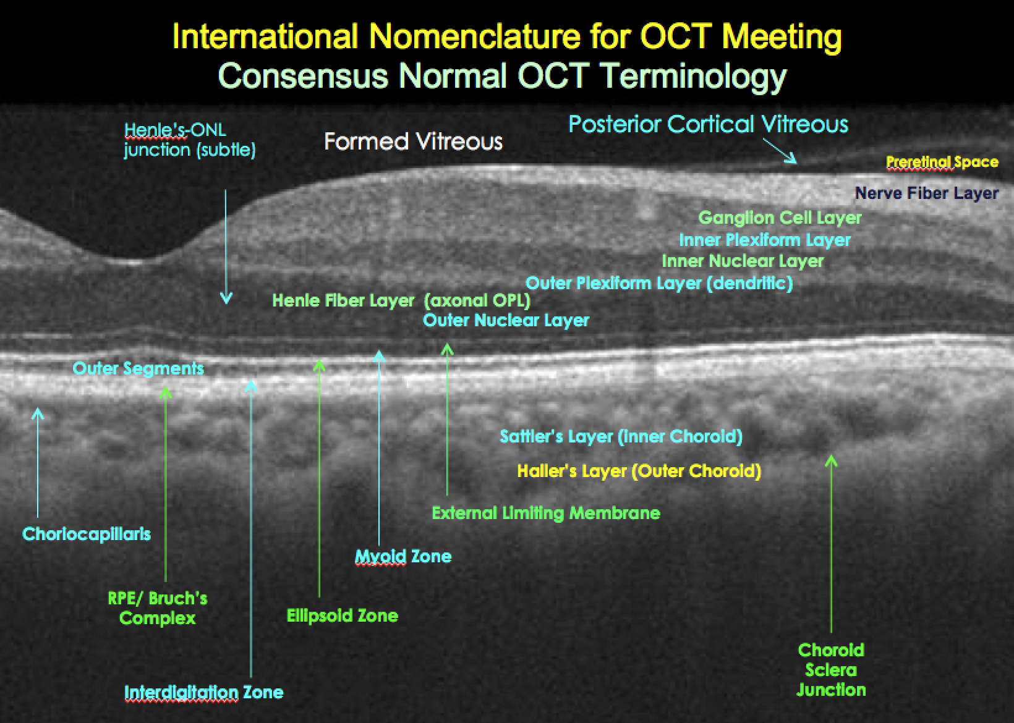

Slide 3
Need to know:
Vitreous – floaters/asteroid hyalosis, h’ge etc
Posterior vitreous face – traction/separation
epiretinal membrane
Lesions in the retina – exudates, aneurysms, h’ge, fluid/oedema
Lesions under the retina – sub-retinal fluid/h’ge/debris
Lesions of the RPE – drusen, atrophy
Lesions under the RPE – RPED/h’ge/scarring/fluid

Slide 4
Vitreous

Slide 5
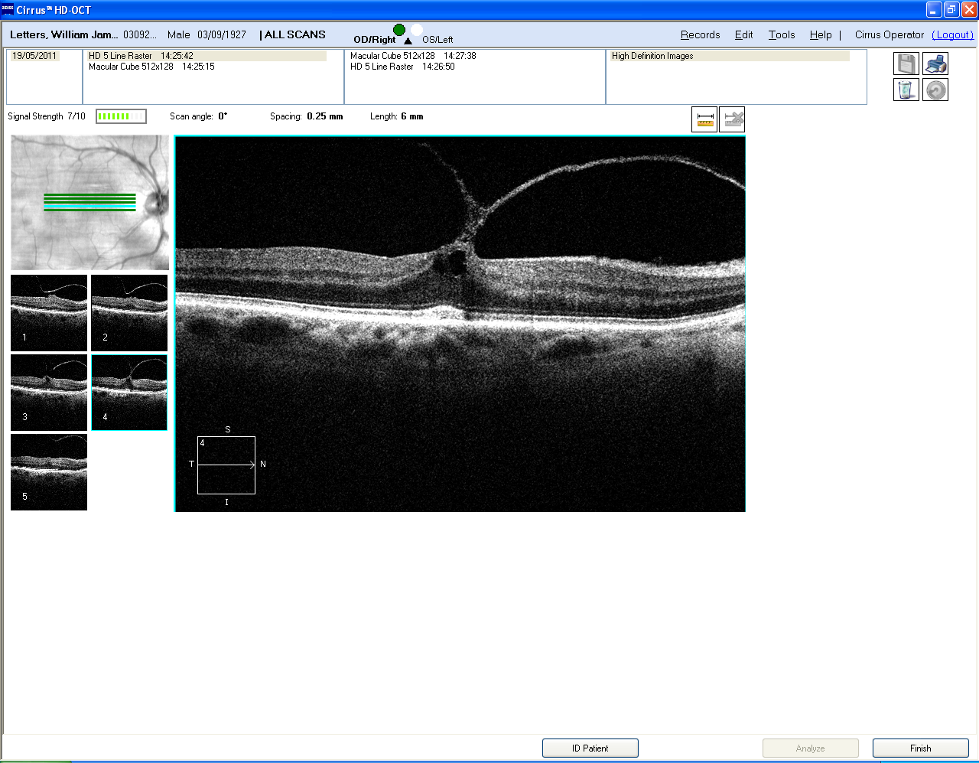

Slide 6
Macular hole

Slide 7
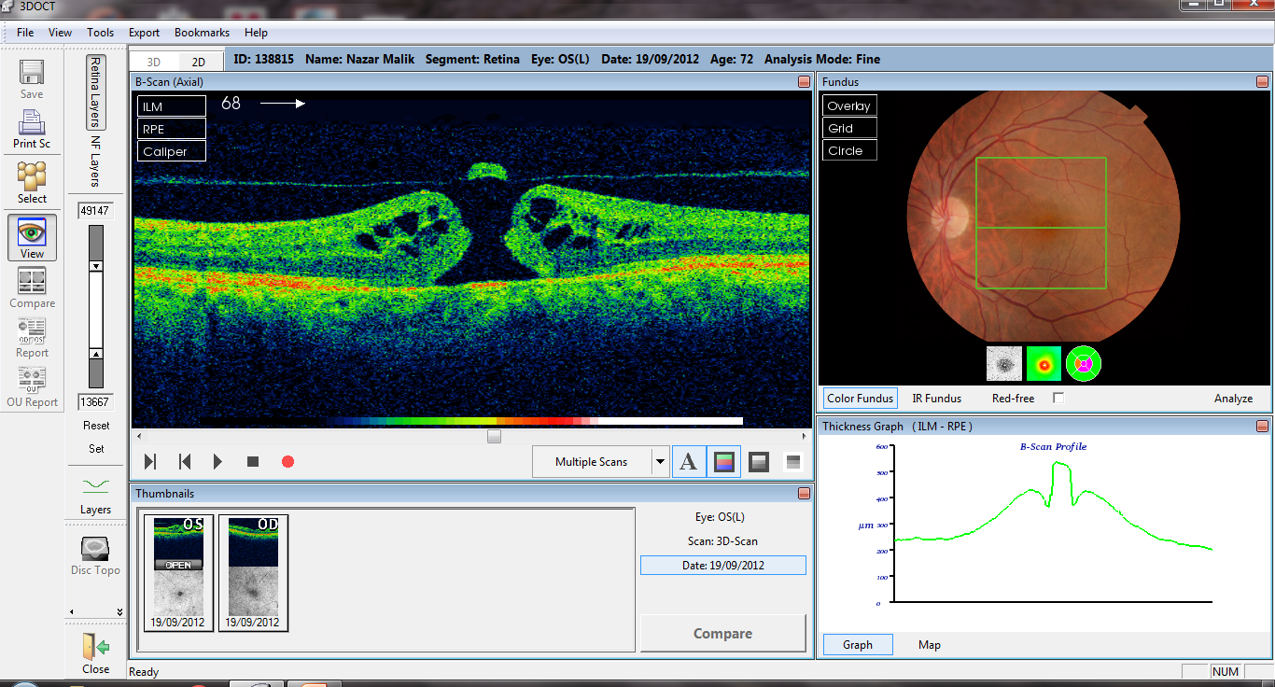

Slide 8
Epiretinal membrane

Slide 9
Intraretinal lesions

Slide 10
Diagnosis of diabetic macular oedema
CSMO
Colour photographs
FFA classification of DMO
Focal
Diffuse
Ischaemic
Mixed

Slide 11
OCT evaluation of DMO
Quantity of oedema
Location of the oedema
Morphological changes of DMO
Vitreo-retinal interface changes
Hyper-reflective spots
Photoreceptor integrity

Slide 12
Location of DMO
OCT based Classification
Centre involving CSMO (clinically significant macular oedema)
Non-centre involving CSMO
Non CSMO
No MO

Slide 13
Maculopathy Description
M1 observable
Lesions within a radius of >1 but<2 disc diameters of centre of fovea
Any hard exudates

Slide 14
Maculopathy Description
M2 Referable
Lesions within a radius of 1 disc diameter of centre of fovea
Any blot haemorrhages
Any hard exudates

Slide 15
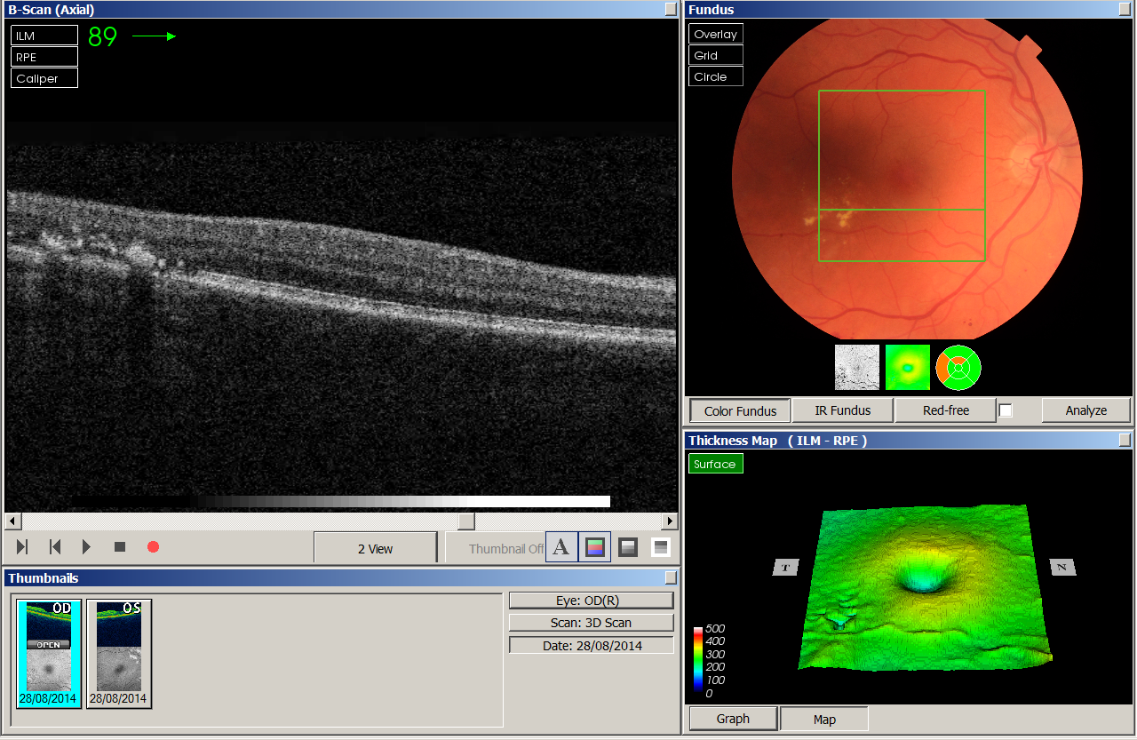

Slide 16
Retinal vein occlusion

Slide 17
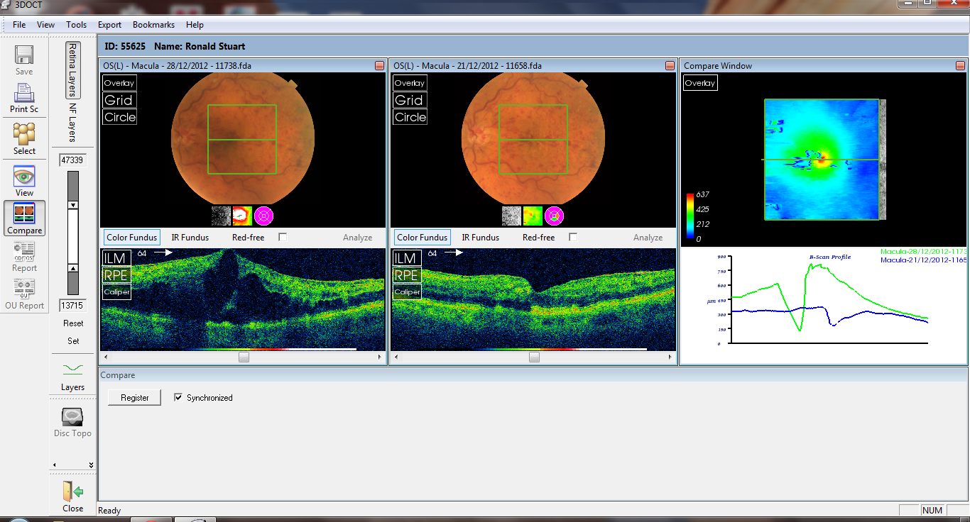

Slide 18
The Retinal Pigment Epithelium

Slide 19
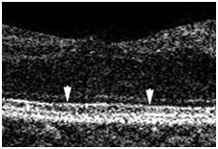
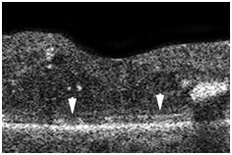
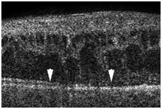
OCT Scans showing the three groups
a) Intact ( Group1)
b) Disrupted (Group 2)
c) Absent(Group3)

Slide 20
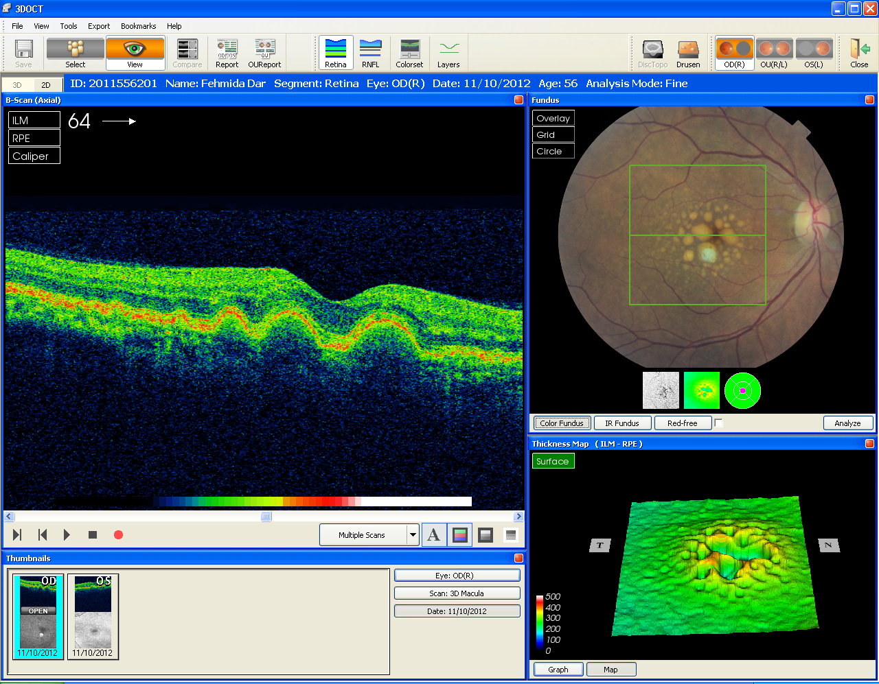

Slide 21
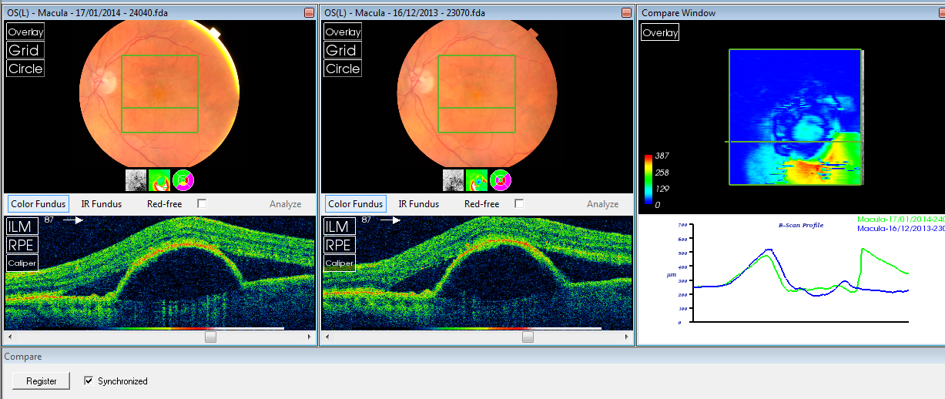

Slide 22
Sub-RPE

Slide 23
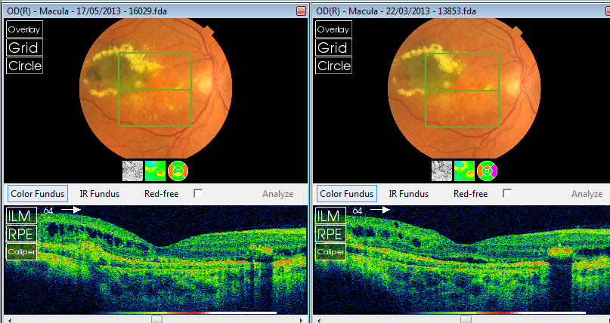

Slide 24
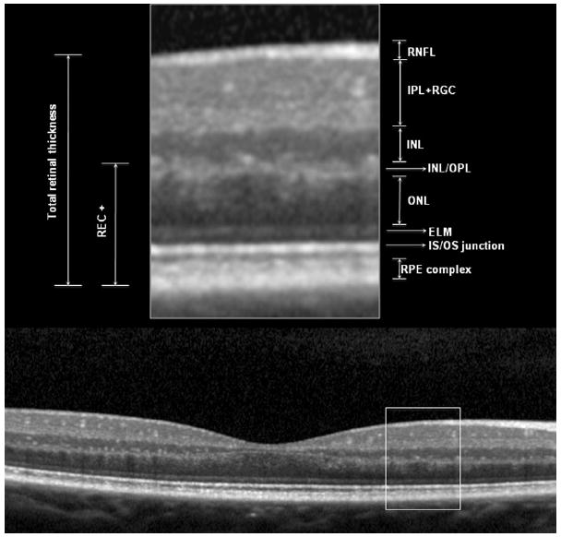
Evaluation of OCT
Vitreous – normal/ adhesions/ detached
Inner retina- normal/ altered
Foveal dip: normal/ absent/ altered
ELM: present/absent
IS-OS- present/ disrupted/ absent
RPE –normal/ absent
Fluid- layer
Deposits – present – which layer

