Slide 1
Fenofibrate for retinopathy
David Preiss
BHF Glasgow Cardiovascular Research Centre
University of Glasgow, UK
13th November 2014

Slide 2
Content
General support for trial
Approach to recruitment
Any suggestions
Fenofibrate: lipid-modifying agent (tablet)
modest cardiovascular benefit (↓10% MI)
promising for retinopathy
£2 per month

Slide 3
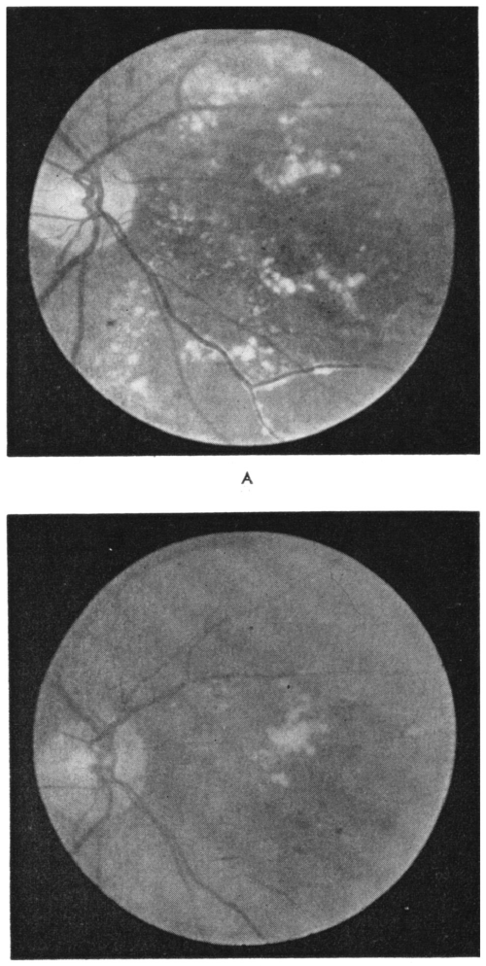
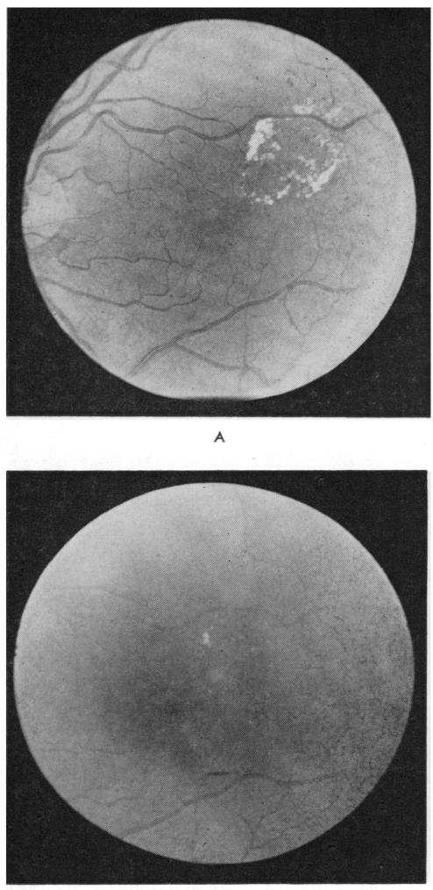
Fibrates and retinopathy: older studies
Clofibrate in exudative retinopathy
n=48
3 years
Hard exudates: ↓ p<0.0001
Vascular lesions: ↔
Duncan L et al. Diabetes 1968;17:458-67

Slide 4
Fenofibrate trials: retinopathy
FIELD
ACCORD Eye
 | Fenofib. n=4,895 | Placebo n=4,900 | P
Laser | 164 | 238 | 0.0002
 | Fenofib. n=512 | Placebo n=500 | P
Laser | 5 | 23 | 0.0004
2 step progress. | 46 | 57 | 0.19
Composite* | 53 | 75 | 0.022
 | Fenofib. + statin n=806 | Fenofib. n=787 | HR (p)
Composite* | 52 | 80 | 0.006
* laser or vitrectomy or 3 step progression
* laser or macular oedema or 2 step progression
Keech A et al. Lancet 2007;370:1687-97
ACCORD and ACCORD Eye study groups. NEJM 2010;363:233-44

Slide 5
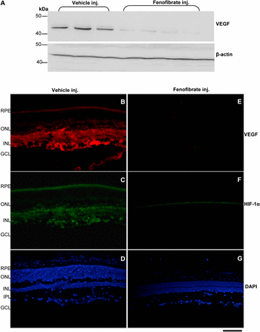
Local effect rather than systemic
Type 1 DM rat model
Fenofibrate: Oral administration
↓ vascular permeability
↓ inflammation: ICAM-1, NFkB
Fenofibrate: intravitreal injection
↓ vascular permeability
↓ ischaemia-induced neovascularisation
Eye drop trials?
VEGF on placebo vs. fenofibrate (intra-vitreal injection)
Chen Y et al. Diabetes 2013;62:261-72

Slide 6
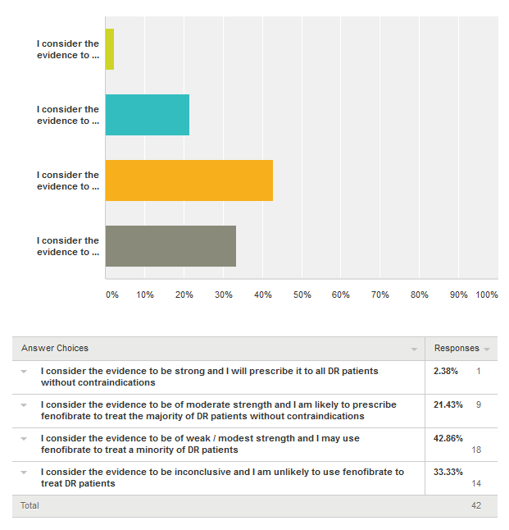
Current status of fenofibrate for DR?
No clear national (or international) position
RCOphth: “Consider adding fenofibrate to a statin for non-proliferative retinopathy in type 2 diabetes. (Level B)”
NICE: no mention; CG66
SIGN: “Although a number of treatments for diabetic retinopathy are of interest, there is no compelling evidence for their routine use”; Guideline 116
Opinion: Diabetes UK 2013; ongoing interest but unsure
Australia: license for DR in Australia; Europe application in

Slide 7
Recent NIHR call for ‘efficient trials’
Rapid start
Efficient conduct
Use of routinely collected data where possible
Simplified design with most important outcomes
Innovations to promote efficient recruitment
Full or partial use of routine data

Slide 8
LENS: Lowering Events in Non-proliferative retinopathy in Scotland

Slide 9
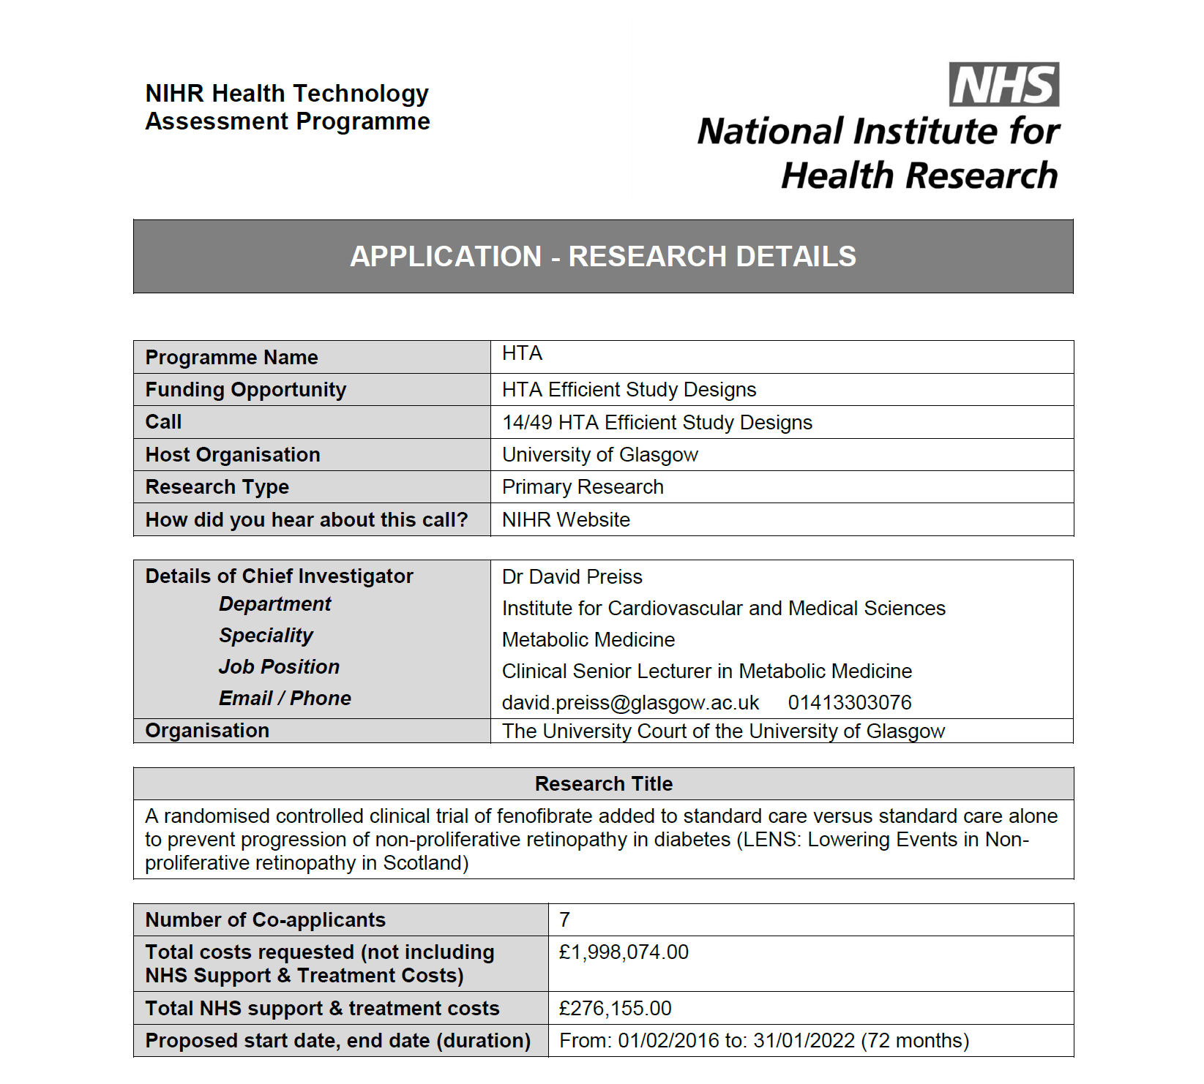

Slide 10
Proposal
Open-label fenofibrate vs. no treatment
Inclusion criteria:
T1DM and T2DM
Non-proliferative retinopathy (M1 or R2 or bilateral R1)
Primary outcome: progression to referable disease
Secondary outcomes:
Visual acuity
Procedures (laser, vitrectomy, VEGF therapy)
Lesions close to macula
Drug mailed out from NHS GGC
Mean follow-up 4 years

Slide 11
Sample size and progress to date
n=1,060
28.8% progress to referable over 4 years (recent data)
Powered to detect 33% reduction
222 events
(n=20,000 to 30,000 with M1/ R2/ bilateral R1 in Scotland)
Passed NIHR’s preliminary stage
Now at outline stage
If successful, starts in February 2016

Slide 12
Estimated numbers to recruit by health board
11 mainland NHS boards | Numbers
Highland | 64
Borders | 23
Lothian | 173
Grampian | 114
Dumfries & Galloway | 30
Tayside | 83
Forth Valley | 61
Fife | 75
GGC | 248
Ayrshire & Arran | 75
Lanarkshire | 116
TOTAL | 1,060

Slide 13
Structure
Executive & steering committees
Management committee: Local PIs etc.
Research nurses
DRS
RCB / health economist
Glasgow Trials Pharmacy
IDMC
Trials manager
SCI Diabetes
SCI Store
ISD

Slide 14
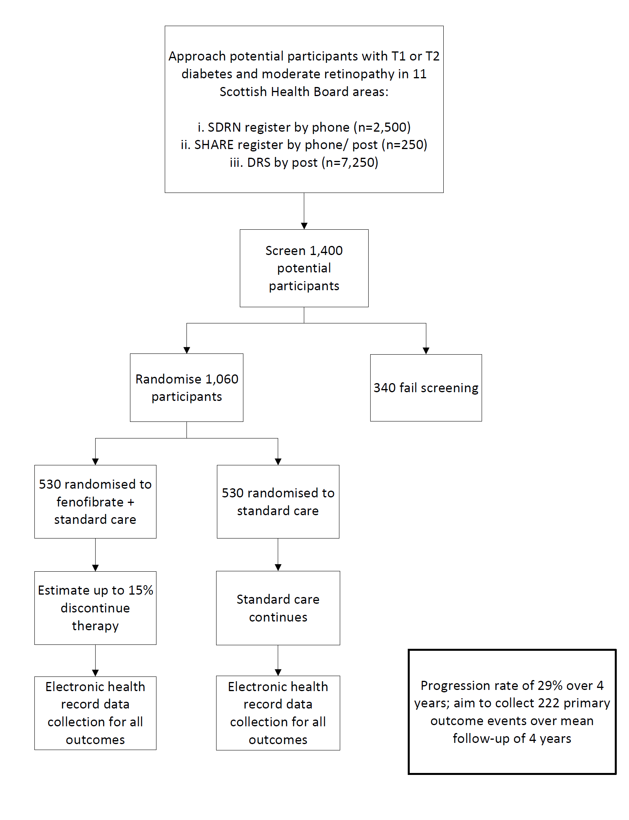

Slide 15
LENS investigators
Glasgow | Aberdeen | Dundee | All health boards
David Preiss | John Olson | Helen Colhoun | Local PIs
Jennifer Logue | Graham Scotland | Graham Leese
Naveed Sattar
Heather Murray

Slide 16
Patient journey
Recruitment options:
SDRN register (n=2,300)
DRS form
Mail-out to all via NHS
LENS flyer at DRS centres
Contacted by research nurse
Screening visit at research centre / hospital
Randomised to standard care or fenofibrate
Drug mailed out
3 month safety visit
No additional face-to-face visits

Slide 17
Strengths
Meets most of NIHR’s desired characteristics ✓
Scottish DRS: existing system, expertise, EQA ✓
SDRN adoption of trial ✓
Health economics work ✓
Other outcomes: renal, CVD, long-term eye ✓
Cheap medication ✓

Slide 18
Recruitment: looking wider than LENS
LENS
Other studies
SHARE
Objective: try to find a way to maximise recruitment opportunities to ALL diabetes studies + in a way that impacts minimally on everyone
Scottish Government: funding probably available

Slide 19
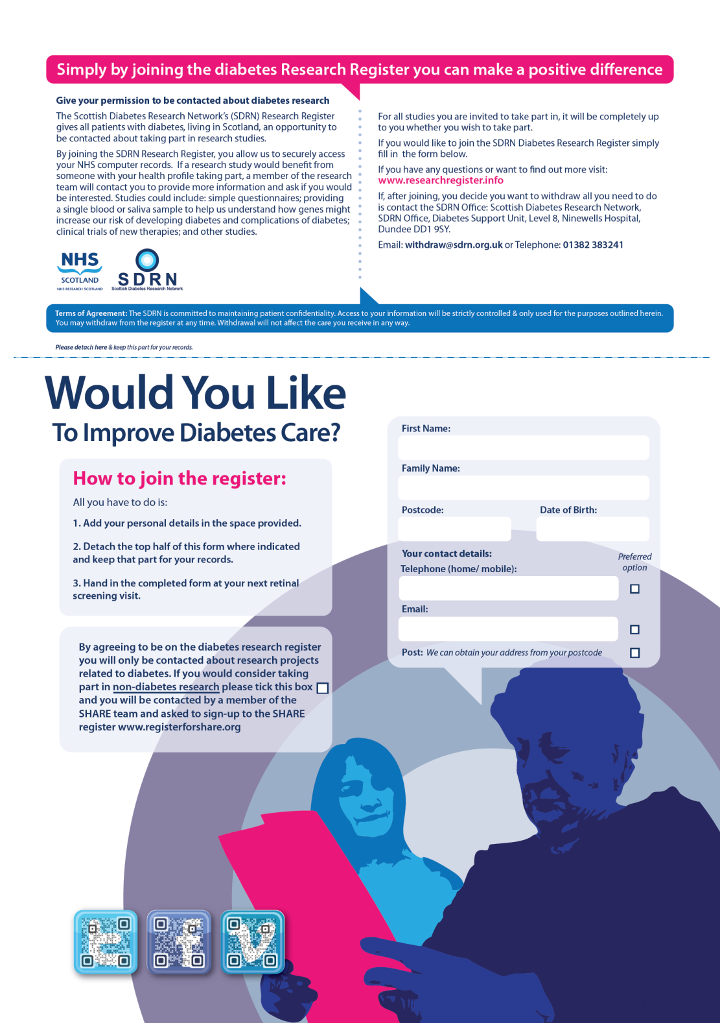

Slide 20
Plan – with your agreement
We liaise with health boards
SDRN form mailed out with DRS appointment
Completed form returned (hopefully)
If no form brought but patient interested – form supplied and completed
Sent by you to SDRN office every XX days/weeks
1.5 year duration

Slide 21
LENS: Lowering Events in Non-proliferative retinopathy in Scotland

Slide 22
Thank you

