Slide 1

Soarian Patients 2014
Mike Black

Slide 2
Diabetes burden – 12 Nov 2014
Total diabetic population on Soarian (KPI 0) = 292,956
Eligible population after suspensions (KPI 0) = 251,986
Number of individuals attending screening at least once (KPI 2 Uptake rate) =
2013 = 80.7% ☺
Today = 79.6%

Slide 3
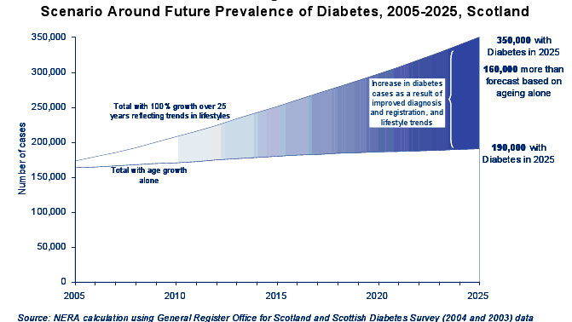

Slide 4
DRS Eligible population

Slide 5
Screening workload in Scotland
Average number of screening episodes per month = 16,725
Average number of screening episodes per working day= 796
Written results to patients within 20 working days = (KPI 9) = 95%

Slide 6
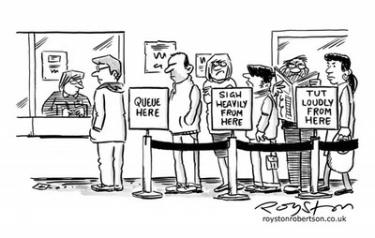
What can we do to prevent …
DRS Appointments

Slide 7
DRS Screening – grading workload
L3 Grading (10,000+)
L 2 Grading (18,000+)
L1 Grading (192,000+)

Slide 8
Ease the DRS workload
The Autograder(Level 0) capable of processing 600 episodes per day.
  But it can only finalise as R0/M0 circa 47% of all episodes processed. The rest is left for manual L1
L2 to L3 graders – new DRS national policy to allow the most experienced and qualified L2 graders to work at L3.
What else can we do ??

Slide 9
Changes to the screening Interval
On the horizon there are potential changes to the screening interval.
4 Nations Screening Interval paper is being presented to the UK National Screening Committee on the 24th Nov.
This is an evidence led research paper produced by all 4 UK devolved nations which suggests that the DRS screening interval could be varied out to 2 years for low risk patients.
  UKNSC may – fully agree recommendations, ask for further information, consider the recommendation or dismiss it.
Any UKNSC recommendation has then to be agreed by the Scottish Screening Committee and Health Department.
Diabetes UK, RNIB and patient groups will also need to be consulted.

Slide 10
Changes to the screening Interval
IT system requirements
  and the IT system.
Risk factors for patients and mechanisms for managing these.
  Blood sugar, age, BP, previous medical history, DNA, diabetes management.
Phase in or big bang approach ??
Potential for up to 40% of current patients to be on a 24 month screening cycle.

Slide 11
Changes to the screening Interval
The decision has yet to be made - so please don’t tell your patients that its happening next year.
Earliest opportunity for us – Son of Soarian – Sept 2016.
What would that mean for the screening workload?

Slide 12
How might those changes affect us

Slide 13
Diabetic Retinopathy Screening – What’s it all about?
Diabetic Retinopathy – historically it’s cited as the biggest cause of blindness in the working age population (16 -64 years old)
A recently published paper in the BMJ (Feb 2014)
  http://bmjopen.bmj.com/content/4/2/e004015.full
Concludes that –
“For the first time in at least 5 decades, diabetic retinopathy/maculopathy is no longer the leading cause of certifiable blindness among working age adults”.
“This change may be related to factors including the introduction of nationwide diabetic retinopathy screening programmes and improved glycaemic control”.
“Inherited retinal disease now represents the commonest cause.”

Slide 14
Finally
Thank You

