Slide 1
Your Guide to Diabetic Retinopathy Screening

Slide 3
Advisory Group
Mike Black Scottish DRS Collaborative Coordinator
Carol Colquhoun National Coordinator Screening Programs, NSD
Norah Grant NHS Lothian, Service Manager
Oliver Harding NHS Forth Valley, Consultant in Public Health
Bruce Knight Patient Representative
Dr Brian Power NHS Dumfries and Galloway, DRS lead clinician
Kirsty Rankin Senior Health Improvement Programme Officer, NHS Health Scotland
Diane Smith NHS Ayrshire and Arran, Service Manager
Dr Joy Tomlinson NHS Lothian, Public Health Consultant
David Steel Communications Director, NSD

Slide 4
The aim of this leaflet is to provide:
Basic information about DRS that a patient needs in order to make an informed choice to attend their appointment
Practical guidance on what to expect at the DRS appointment
Approved sources of further information

Slide 5
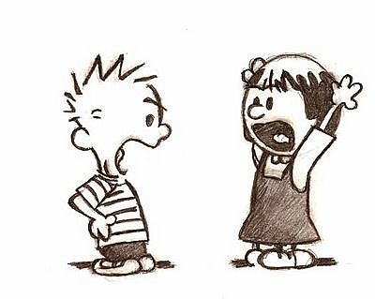
The content was subject to much debate!!

Slide 6
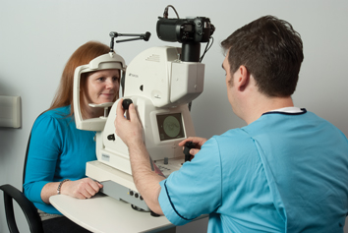
DoH leaflet structure with significant changes to text
Lengthy discussion and debate on content
Fresh design
Photo shoot to accurately illustrate a DRS appointment
Practical

Slide 7
Consultation with Patients:
Clear key messages
Accessible
Design
Health Inequality Impact Assessment

Slide 8
Alternative languages and formats:
Chinese, Urdu, Polish
Easy read
Plain English
Regular opportunities to review and update

Slide 9
Available from NHS Health Scotland in the new year
Guidance on ordering material will sent in due course
To feature on the Screening zone www.nhsinform.co.uk/screening
Websites e.g. sky diabetes

Slide 10
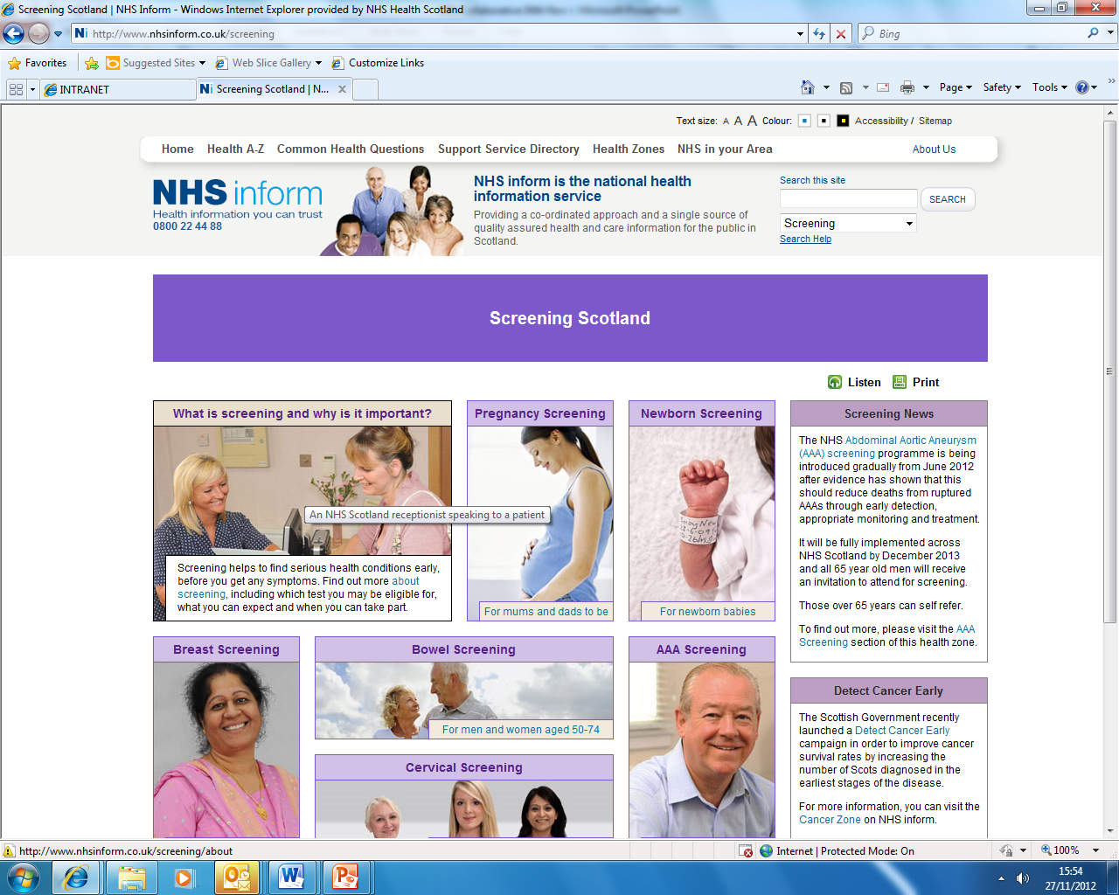

Slide 11
NHS Health Scotland
Screening and Immunisation Team
Nuala Healy nualahealy@nhs.net
Programme Manager
Kirsty Rankin kirstyrankin@nhs.net
Senior Health Improvement Programme Officer

