Slide 1
Automated Grading
…..and a reference for the rest of us!
Neville Lee (DRS System Specialist)
Mike Black (DRS Collaborative Coordinator)

Slide 2
Topics
Implementation Options
Architecture
Autograding Process
Performance
Contract & Costs
Future Developments
Notes:
Autograding
Brief overview of the autograding solution to date
Presentation will focus on:
Infrastructure and options that were available to us
What the current set up looks like
The current process for autograding examinations
Problems encountered
Performance and throughput
Future Developments
I will make a number of references to 2 components – iGrading and Blue Prism
Blue Prism – interface between Soarian and iGrading. Acts like a human L1 grader. Demo later
iGrading – gets a feed of retinal images for analysis
The presentation will not focus on the clinical aspects of autograding but rather how it interacts with Soarian

Slide 3
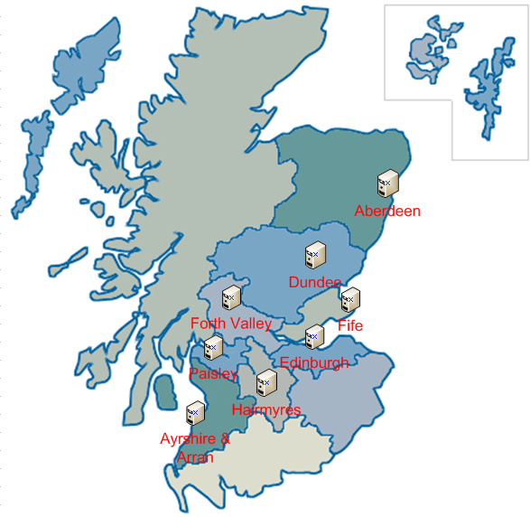
Distributed at Grading Centres
Notes:
There were a number of options available for an autograding solution. Account had to be taken of costs, technical support, configuration and future developments.
Option #1 - Distributed
Autograding software would need to be installed on 8 servers
Remote access would need to be enabled for Medalytix/DRS system specialist for each grading centre server
Difficult to troubleshoot – reporting technical problems to each Grading Centre eHealth Department!!
CLICK - Too Expensive

Slide 4
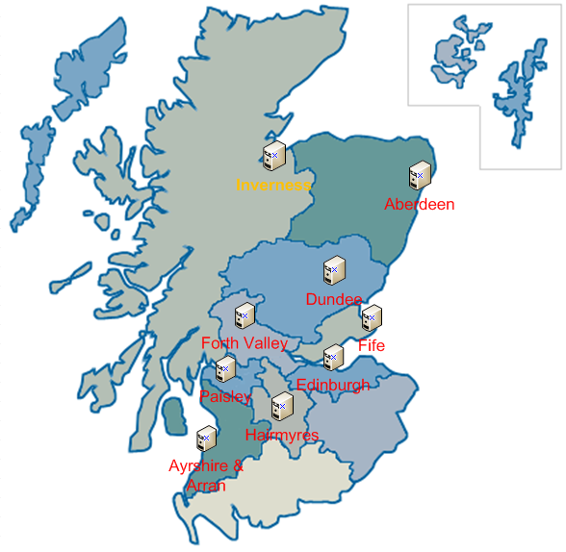
Hosted from NHS Highland
Notes:
Option #2 – Hosted in NHS Highland
Certainly easier to control and manage
Requires firewall rules between NHS Highland and other Health Boards
Would NHS Highland be happy to manage this system?
What happens if future DRS system specialist/coordinator are not located in NHSH?

Slide 5
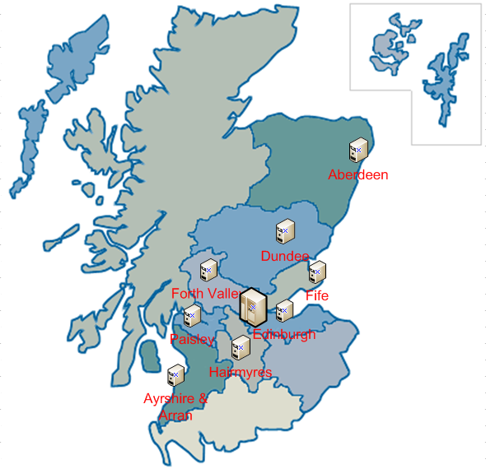
Centrally Hosted
Notes:
Option #3 Centrally Hosted
Centrally hosted – mirrors existing Soarian set-up
Only one remote access setup required for Medalytix
Existing remote access can be used by DRS system specialist and coordinator
Hardware Infrastructure already in place to support virtual Machines
Easier to troubleshoot issues
Closer to the national DRS system to change the system in the future
Option 3 was the most viable option.

Slide 6
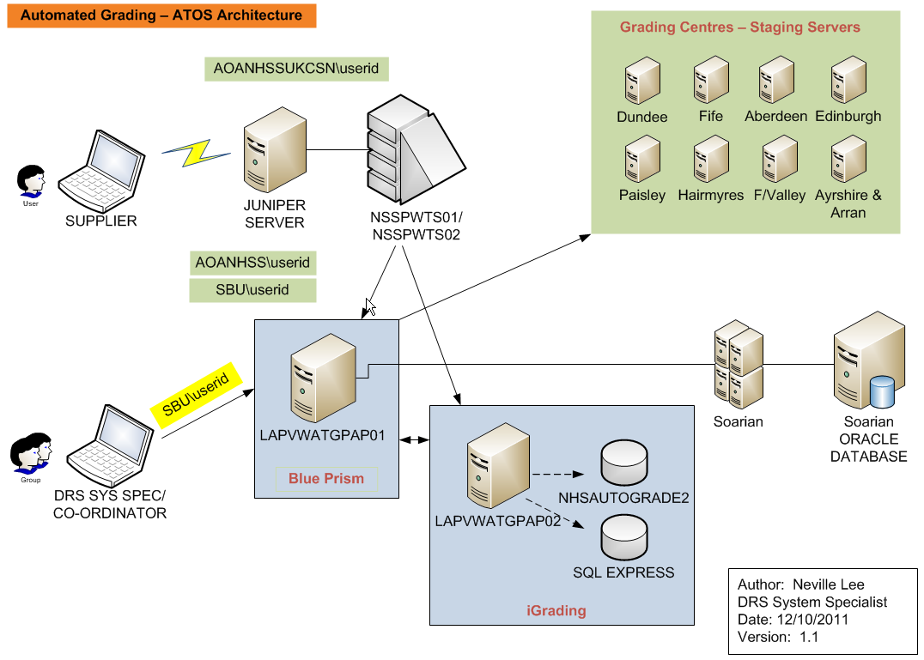
Autograding Solution
Remote Access
Soarian
Blue Prism
iGrading
Notes:
Autograding Solution
CLICK - Remote access for supplier to troubleshoot any issues
CLICK - VM running Blue Prism which interfaces with Soarian and passes extracted examination details and images to iGrading. Also imports iGrading results back into Soarian.
CLICK - VM running iGrading that analyses the retinal images and determines if the images are adequately visualised, contain no disease or disease has been detected.
Why use VMs – VMs give us greatest flexibility. We can adjust the specifications of the server relatively easily without incurring huge costs. No additional power or storage space is require to host a VM – it does not physically exist.
CLICK - Soarian has 9 autograder accounts set up that are associated with a grading centre and not a Health Board e.g. the DUNDEE autograder will grade examinations from Tayside, Western Isles and Orkney. Soarian then controls what the autograder will see using existing Soarian controls.
Using this setup means that all the actions the autograder performs on Soarian are auditable i.e. it acts like a human L1 Grader.

Slide 7
Implementation Timeline
19/07/2011 Build Infrastructure
18/08/0211 Install and Configure Autograding Applications
01/09/2011 Run Tests
19/10/2011 Go Live
01/04/2011 Funding/Contract Approved and Signed
Delays in getting ATOS Resource
Issues with ATOS configuration
Remote access problems
Firewall issues
Interface issues
Software applications problems
User account issues
Notes:
Implementation Timeline
Implementation has been plagued with resource issues and technical problems
Delayed in testing against Soarian Test system
Connection issues with Grading Centre Staging Server . Initially we thought that access to these was not required as we concentrated on the oldest L1 grading tasks.
The configuration of the Soarian test system and Live are different and Live will always check the staging server first even though the retinal images have been loaded in to the DRS database – apart from examinations taken today
Issues with the performance of the iGrading server which is running at 100% causing delays in processing images sent from Blue Prism. – we have recently added another processor. I will discuss throughput shortly
Soarian application causing issues due to performance problems when a database backup is being taken and due to the application being restarted every night due to an existing Java problem.
The way the soarian application work using java and javascript can also throw up problems.
However, Blue Prism gives us the greatest flexibility while we gain more experience of the way Soarian behaves in the Data Centre environment.

Slide 8
Extraction and Analysis Process
Connection
Login to Soarian
Goto L1 Not Started Queue
Sort and Filter
Process Urgent Examinations
Sort L1 Task List Oldest First
Analyse
Process Episode Images
Process L1 Tasks
Single Eye Exams
Not Adequately Visualised
No Disease Detected
Defer L1 Tasks
Save Examination images
Pass to iGrading
Disease Detected
Notes:
Extraction Process
Show Extraction AVI file – Ensure speed setting is high on Media Player. Use Alt-Enter to bring up full screen
If Blue Prism detects any urgent cases in the L1 queue initially it will mark them as R1 so they are escalated to L2 to prevent sending them to autograding. – Note: The first 4 examinations are urgent so go slowly through them
If urgent examinations appear in the L1 queue during the extraction process then they will be sent to iGrading.
If during the extraction phase a single eye examination is found then it will be marked as R6 so they are passed to the L2 grader.
Non-urgent examinations then have their images saved and sent to iGrading. – Refer to AVI file
Blue Prism acts like a human grader and therefore all actions are subject to the same constraints as a normal Grading account.
Timings
To extract an episode with 3 images from Soarian using Blue Prism takes approx. 2.5 mins.
iGrading takes approximately 3.5minutes to analyse an image
So we are looking at between 4-6 episodes an hour as a benchmark
The system will also generate an email to a specific email address if problems occur during automated grading

Slide 9
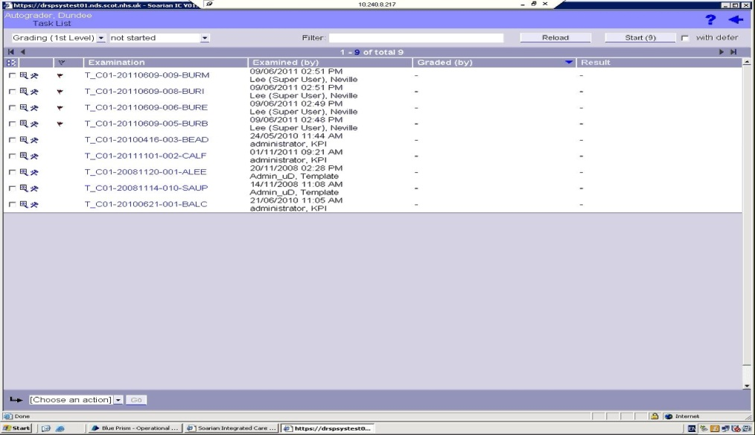
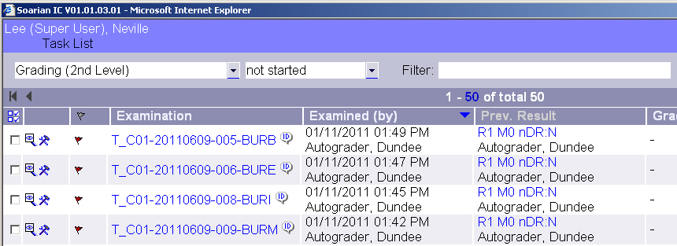
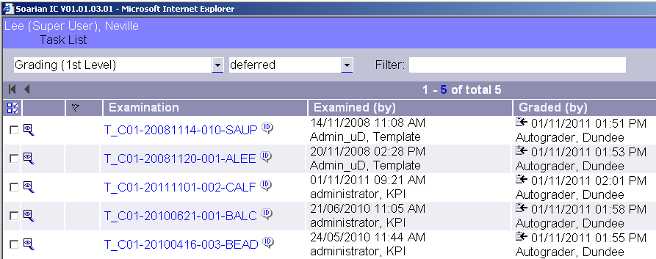
Soarian Task List
Before and After Extraction Process
BEFORE
AFTER
Urgent
Grading (1st Level) Not Started Queue
Deferred
Notes:
Screenshots of post extraction impact on Soarian L1 Grading Tasks
CLICK - All existing Urgent not started L1 Gradings are given result R1 and passed to L2 Grading.
CLICK - All extracted L1 Grading Task sent to iGrading are deferred whilst the images are being analysed.
If any problems do occur then the examinations will remain in deferred queue and can be manually undeferred later. This action will currently be completed by the system specialist but can ultimately be done by a designated staff member using their associated Grading Centre autograding account.

Slide 10
Import Process
Results Extraction
Connect to iGrading
Update Soarian
Login to Soarian
Process L1 Deferred Task List
Extract Results
Notes:
Show Import AVI file – Ensure speed setting is high on Media Player – ALT-ENTER to run full screen
This process takes the results from iGrading and places them back into Soarian
As mentioned previously L1 tasks sent to iGrading are sitting in the deferred queue
Where disease has been detected then micro-aneurysms /dots field is set to Yes to create a result R1. Automated Grading will never mark features to get a referable result . This is sufficient to pass this to the L2 Grader.
No disease detected gets the default Soarian settings to generate R0M0
Technical Failures update the Quality of the Image as Not adequately Visualised to get the result R6
Timings
Blue Prism takes approximately 2 – 2.5 minutes to put the results back in Soarian. This is again subject to any network latency or other performance problems that might be present.

Slide 11
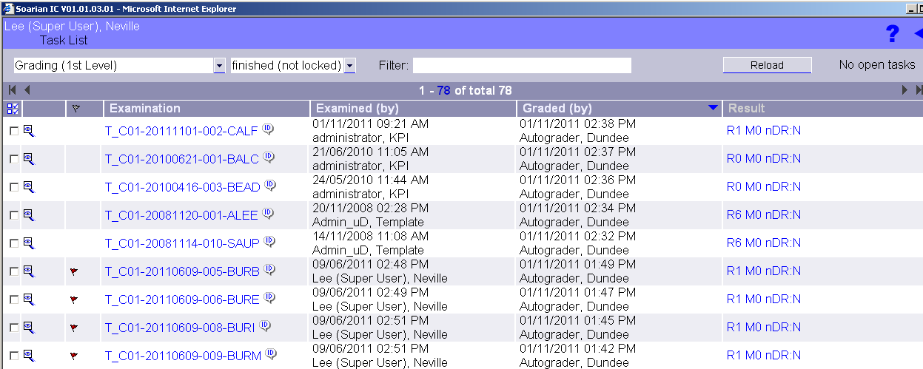
Soarian – Post-import Process
These tasks were graded by iGrading
Notes:
Screenshots of impact of import process on Soarian
The slide shows us the aftermath of autograding and associated results
The extraction and import processes are launched from the command-line
We can specify which Grading Centre and the number of episodes to be passed to iGrading
Because of this setup we can use Windows scheduler to automatically launch th extract and import process for specific Grading Centres and number of episodes.
This gives us the flexibilty to be able to create and edited schedules easily
To accommodate any system downtime
To increase workload for a specific Grading Centre as and when required.

Slide 12
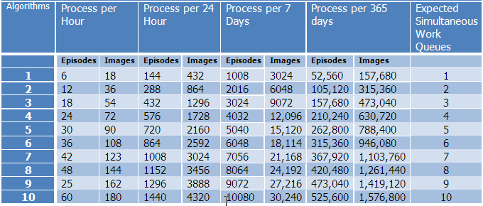
Throughput
The following table depicts how much work can be done according to the amount of algorithms that are provided to the iGradingM v1.0 system. These figures are based on an episode having 3 images.
Notes:
Increasing Performance and throughput
the heart of iGrading - Algorithms – A set of instructions for carrying out a procedure or to solve a problem. This is
Basically, the more algorithms the greater the throughput.
iGrading is quite demanding on a Server’s resources and will use 80-90% of the processor (the heart) of the server. This can cause problems as the server tries to deal with other housekeeping tasks.
The virtual environment means it is relatively straightforward to add additional processors. We have done this now. We are now running a dual-core processor i.e. 2 processors. This will allow us to add another algorithm to improve throughput shortly.
CLICK – I luv Algorithms
CLICK - Ideally we want to increase the number of algorithms to 4. We can then expect to process in the region of 180,000 L1 tasks per annum taking into account downtime and other technical issues.
Handover to Mike

Slide 13
Contracts
Current contracts all signed - 30th March 2011
Medalytix only for 12 months (until April 2012)
ATOS for 12 months from go-live. (We have yet to accept the hardware as go-live)

Slide 14
Costs to date
Medalytix - £98,496
Blue Prism licences (x2) - £6000
Installation and integration (one-off) - £33,300
Support pack (25 days) - £20,000
Service pack - £18,750
Project management (one –off) - £4,030
Vat - £16,416

Slide 15
Costs to date
ATOS - £32,668
One-off set up - £22,000
Plus for 2011/2012 - £10,668
Extra hardware ???
- £4300 per server PA.

Slide 16
Costs looking ahead 2012
ATOS - £20,367 (plus RPI annually)
Medalytix - £134,700
Licence fee for BP - £6000
Remote support - £750 per day @ 67 days
Service & Dev - £750 per day @ 75 days
Total - £112,250
Vat - £22,450
Auto-grader total - £155,067

Slide 17
Costs looking ahead 2012
Auto-grader costs would be top sliced from participating Health Boards by NSD.
Pro-rata based on L1 grading carried out??
The more L1 auto-grading we do the cheaper it gets as the costs are essentially fixed.
Collaborative need to decide by April 2012

Slide 18
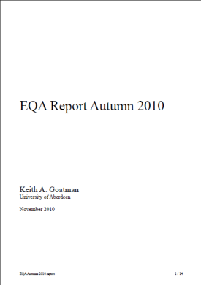
Future Developments
✗
✓
?
?
?
?
Notes:
Future Developments
CLICK - EQA. Not a future Development but a present one. The images used in the last round of EQA have been fed to the iGrading system. The results were fed to Keith for inclusion within this round’s report that Ken mentioned.
CLICK - Remove Blue Prism all together or minimise its interaction with Soarian.
CLICK - Directly communicate with the DRS database rather than through the application. Investigate the use of middleware – the weapon of choice for eHealth
CLICK - Improve process management through proactive reporting via email and SQL.
CLICK - More efficient scheduling to maximise throughput.
CLICK - Who knows where this will lead

