Slide 1
Ophthalmology in Malawi
DR JOSEPH MSOSA

Slide 2
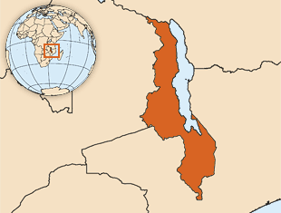

Slide 3
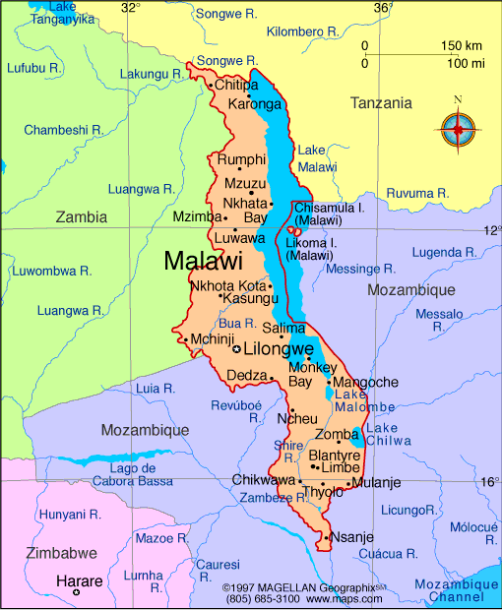

Slide 4
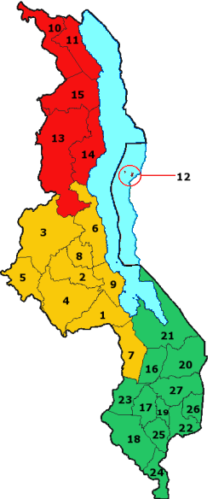

Slide 6
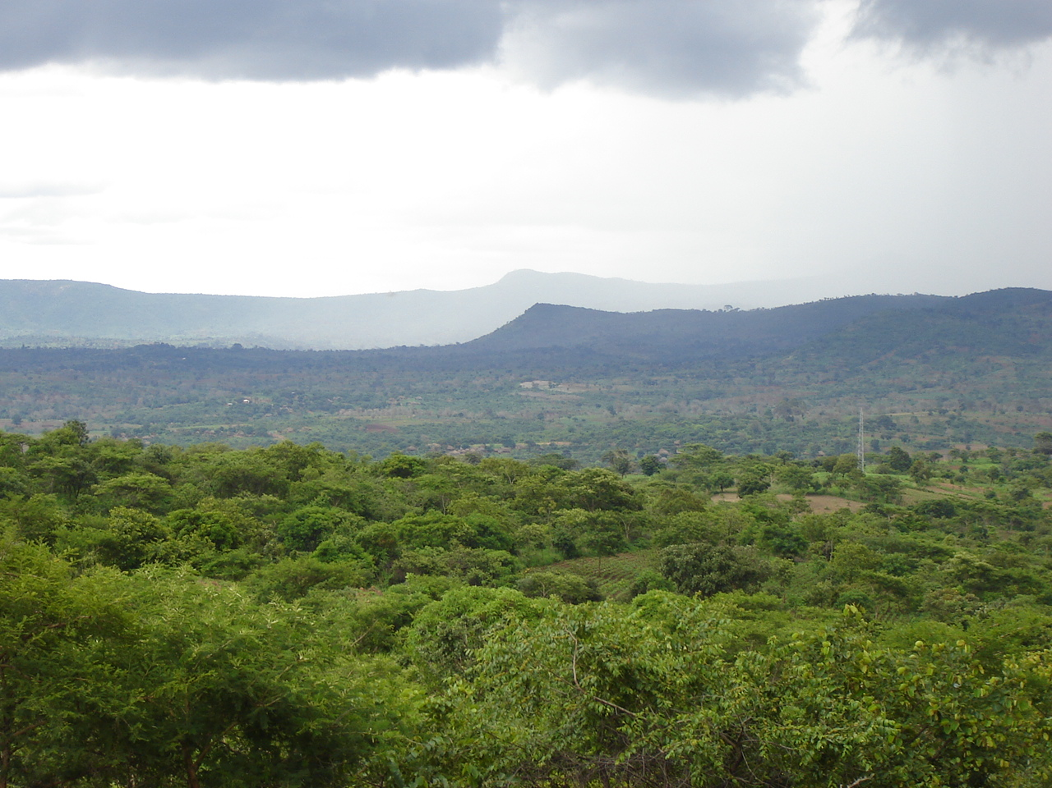

Slide 7
MALAWI
Population :15,900,000
Gross national income per capita: 730
Life expectancy at birth m/f (years,2012): 58/60
Infant mortality rate: 40.1 deaths/1,000 live births

Slide 8
Health Staffing
2 Physicians per 10,000 population
4 Nurses and midwives per 10,000 population.
8 Ophthalmologists

Slide 9
LIONS SIGHTFIRST EYE UNIT: KCH

Slide 10
Central Region
Referral Hospital in Central Region
Catchment Population: 5,510,195 (2008 census)
Area: 35,592 km² (13,742 sq mi)
Two Ophthalmologists

Slide 11
DISEASE BURDEN

Slide 12
CATARACT 50%

Slide 13
TRACHOMA 15%

Slide 14
GLAUCOMA 15%

Slide 15
CHILDHOOD BLINDNESS

Slide 16
REFRACTIVE ERROR

Slide 17
DIABETES

Slide 18
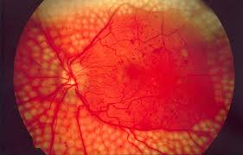
PRP

Slide 19
SITUATIONAL ANALYSIS
What is the Need
POPULATION AT RISK
Total Population | 14m
Population to be covered (consider age) | 7m
DIABETES MELLITUS
Prevalence of DM (number DM / 100 pop) | 5%
Number of people with DM | 350,000
DIABETIC RETINOPATHY
Proportion (%) of DM with Diabetic Retinopathy | 35%
Number of people with Diabetic Retinopathy | 125,000
VISION THREATENING DIABETIC RETINOPATHY
Proportion of diabetics with VTDR | 10%
Number of people with Vision Threatening DR (VTDR) | 35,000

Slide 20
SITUATIONAL ANALYSIS
What is being done?
KEY INDICATORS
How many diabetics need an eye examination each year? | 350,000
How many people with VTDR need treatment? | 35,000
CURRENT STATISTICS
How many diabetics have an eye examination each year? | 2,250 – made up of 750 (Lil) and 1,500 (Bl)
How many people with VTDR have treatment each year? | 230

Slide 21
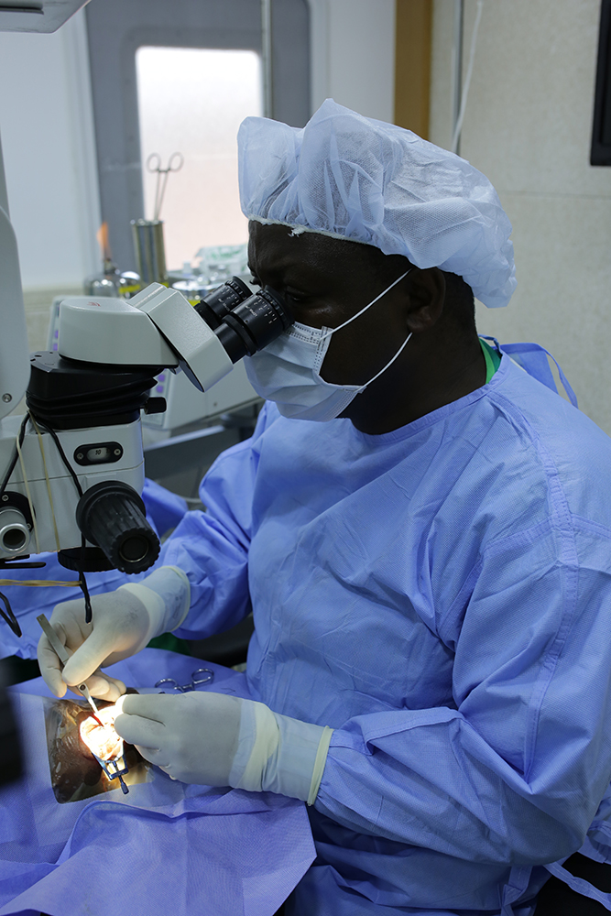

Slide 22
EQUIPMENT

Slide 23
EQUIPMENT

Slide 24
EQUIPMENT

Slide 25
EQUIPMENT

Slide 26
LOW VISION

Slide 27
LOW VISION

Slide 28
CHALLENGES
No Data base for diabetic retinopathy
No screening program
No Fundus camera/ OCT/ fluorescein angiography
Erratic supply of surgical consumables for VR

Slide 29
WAY FARWARD
Establish and Manage a diabetic retinopathy screening program
Through the LINK: LILONGWE- EDINBURGH/FIFE
Funded by Queen Elizabeth Diamond Jubilee trust Fund

Slide 30
Plan
Create data base for diabetic retinopathy
Start a diabetic screening program- Start with patients in the diabetic clinic
Train Ophthalmic Technicians( OCO) and Optometrists in screening, grading and Fundus photography using FIFE camera
Train Ophthalmic technicians/Optometrist to do PRP
Increase Laser sessions to twice a week

Slide 31
THANK YOU

