Slide 1
DRS Meeting Programme
Steele Lecture Theatre
Perth Royal Infirmary
Welcome Mike Black
1.00pm Chairman’s Welcome Dr Caroline Styles
1.10pm Where will Retinal Screening go in the Future? Professor Graham Leese, NHS Tayside
1.40pm Organising OCT clinics Margaret Bruce, Service manager, NHS Grampian
2.00pm Improving the Value of Screening For Macular
Odema using Surrogate Photographic Markers Dr John Olson, NHS Grampian
2.40pm Patient Information Leaflet Nuala Healy, Programme manager for Screening and Immunisation, NHS Health Scotland Team
3.00pm Questions and Answer session
AOCB
4.00pm Meeting Close

Slide 2
DRS Meeting Programme
Steele Lecture Theatre
Perth Royal Infirmary
Mike Black
DRS collaborative coordinator
NHS Highland

Slide 3
DRS Meeting Programme
Steele Lecture Theatre
Perth Royal Infirmary
2011 2012
TP 259,917 270,411 (+4%)
EP 224,793 232,874 (+3.6%)
UR 179,834 184,741 (+2.72)

Slide 4
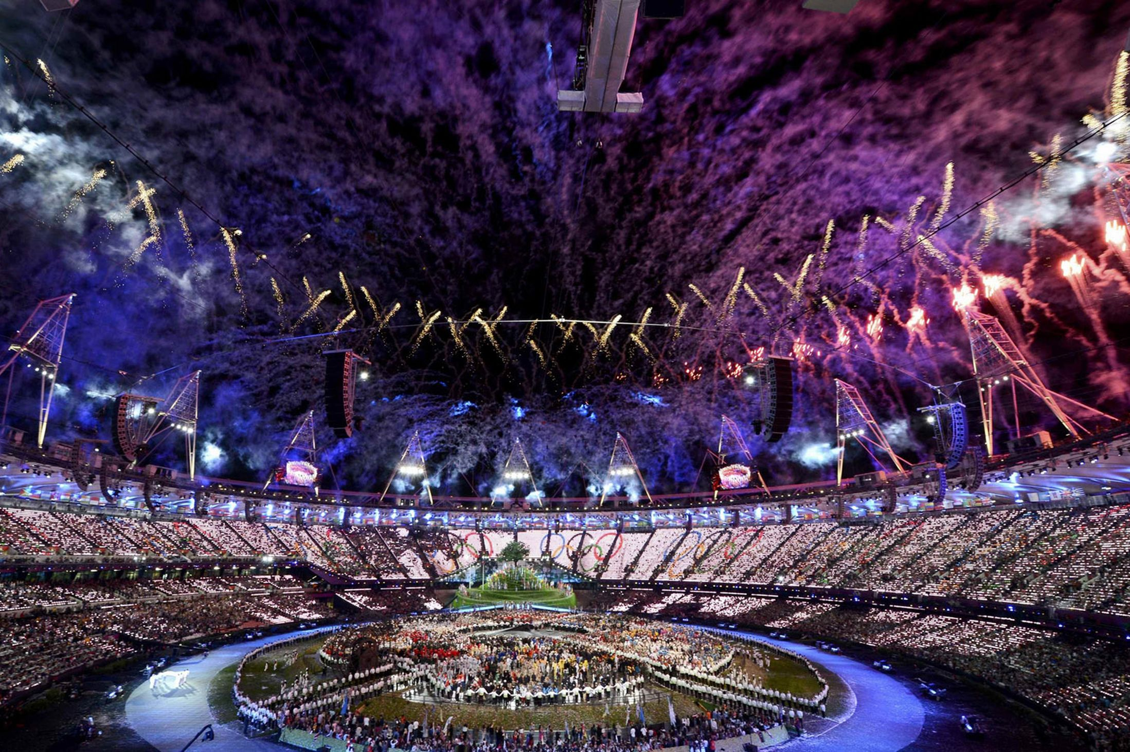
DRS Meeting Programme
X 2
Steele Lecture Theatre
Perth Royal Infirmary

Slide 5
DRS Meeting Programme
Steele Lecture Theatre
Perth Royal Infirmary

Slide 6
DRS Meeting Programme
Steele Lecture Theatre
Perth Royal Infirmary
Thank you

Slide 7
DRS Meeting Programme
Steele Lecture Theatre
Perth Royal Infirmary
Dr Caroline Styles
NHS Fife

