Slide 1
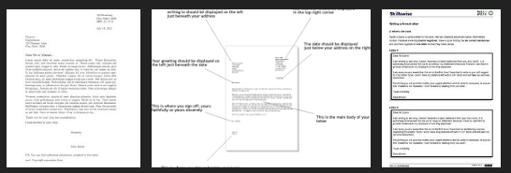
11/10/2014: New Release v01.01.04 went live
10/11/2014: Fix applied to Soarian. v01.01.04.01 went live
Health checks by ATOS/Siemens to be arranged soon.
New mobile client to be released shortly
Database/Server software patches to be applied
DRS Letters
DRS Replacement IT System
Notes:
Release of new Soarian version
Compatible with IE8.0 and Windows 7
Initials false starts with upgrade Problems with database/performance. No loss to screening service
Post-release Problems registering new diagnosed patients
Resolved with hotfix v01.01.04.01
Systems are getting back in synch
Health check is being requested to ensure that we are getting the best out of the system
In the Pipeline
DRS Letters changes to be applied to UAT/Training environments before being applied to LIVE
DRS Replacement System
i. A couple of options on the table
a. Out to the market for full replacement
b. DRS Screening module in SCI-Diabetes
i. No Interface required
ii. System in place in Health Boards
ii. Currently being discussed at National eHealth meeting

Slide 2
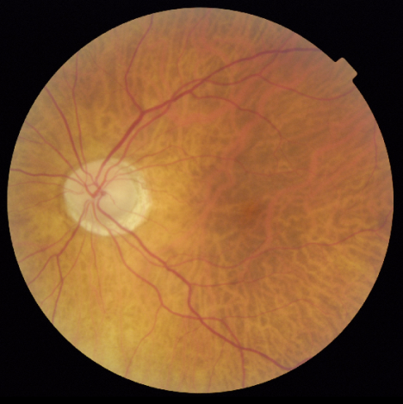
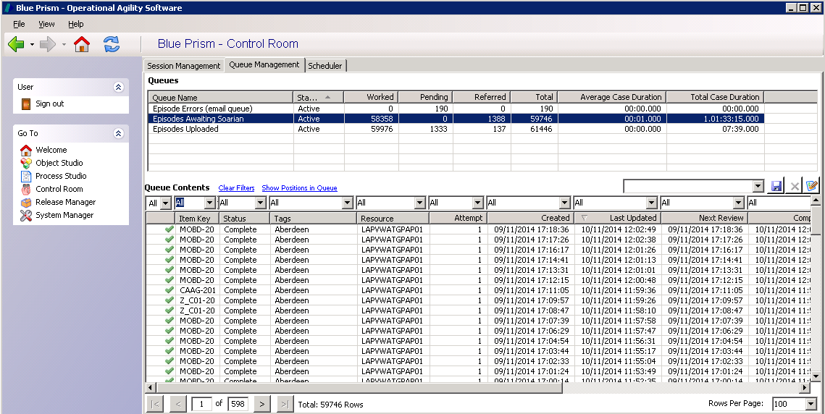
Autograder
600 grading cases per day
Improved reporting
Improved error handling
Notes:
Autograder
Interface changes
Changes made earlier in the year to return disease detected/technical failures cases for human grading
Increased throughput - Target is to autograde 600 grading cases per day. This will allow us to complete the L1 Grading queue
Recently made improvements to error handling and reporting
Scalable solution – increases the throughput by adding additional robots

Slide 3
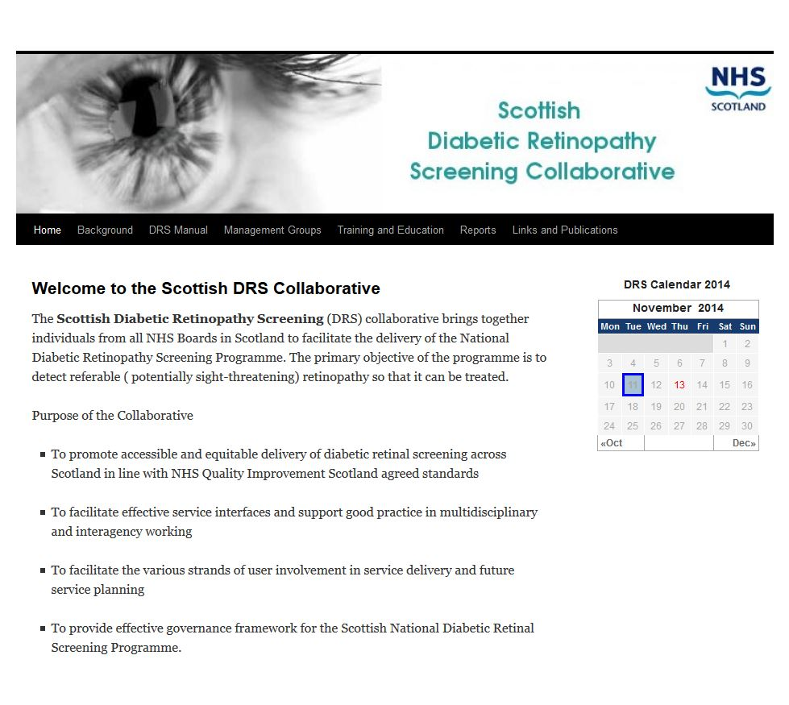
The New DRS Website
Notes:
Old website
Difficult to manage and change content
Out-dated look
Difficult to search on
New website
Makes use of newer web technology
Greater flexibility to change content
Easier to add content
Wide range of plugins and themes available
Allows greater collaboration to write ad produce content

Slide 4
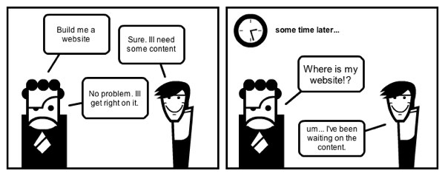
Notes:
Effective Websites
Having appropriate content that caters for website users
Having new content available dynamically
Inform you of new content being available
Becoming a portal to other useful websites

Slide 5
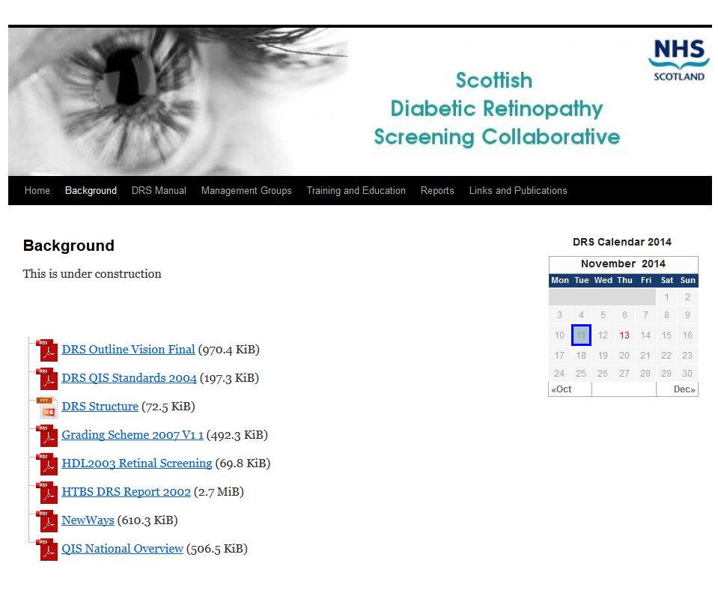
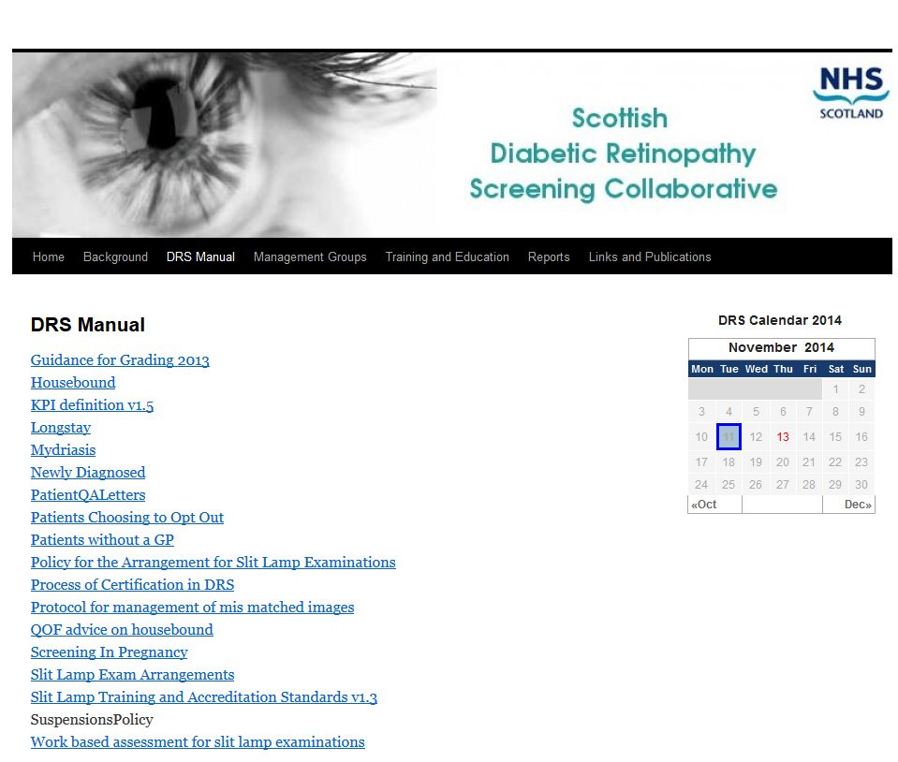
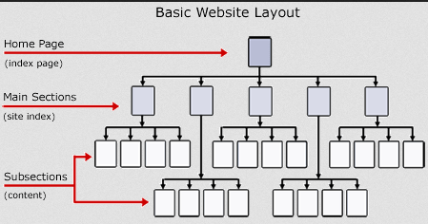
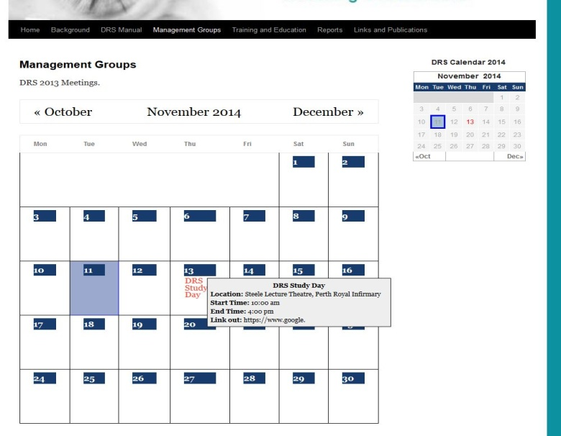
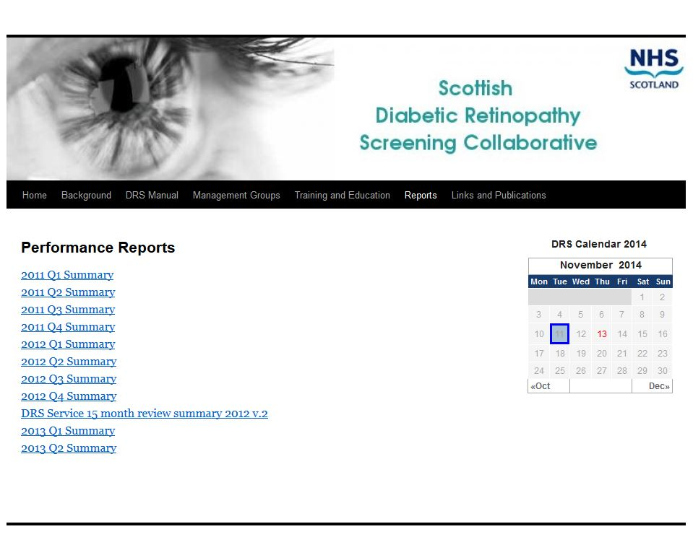
Notes:
Current situation
Started to develop basic structure
Added plugins document mamagement
Added calendar plugin that can be used for meetings

Slide 6
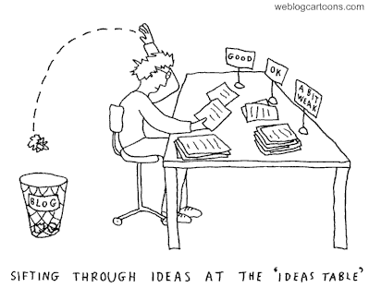
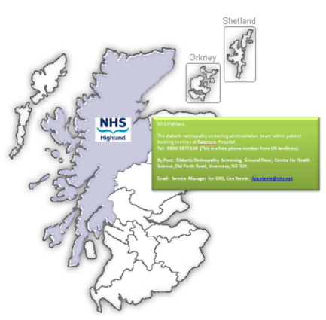
Notes:
Aims
Define Public/Private boundary
Public
Maintain some basic information on DRS in Scotland
Contact numbers of DRS offices
Links to Health Board websites
Links to NHS Inform – Use existing websites
Links to mydiabetes*myway site
Private
Get DRS users to use the website more
Email users when new content is uploaded
Provide latest news from the Diabetes/Ophthalmology
Provide latest Scottish DRS news
Allows links to The knowledge Network – a more secure areas for having a DRS forum

Slide 7
D.R.S
Notes:
However this is a Collaboration and not the Mike and Nev show
So we need your input

